Slide 1
Quick Start Finance
A “Younger” Personal Finance Application
Version 1.0
Ryan L. Buchanan

Slide 2
Quick Start Finance - Purpose
A “Younger” Personal Finance Application
The purpose of the Quick Start Finance application is to enable young users to track their personal budgets of income and expense in an easy-to-read, simple manner.
Our hope at the Quick Start Finance Company is to urge the young people of America to begin taking stock of their financial situation and ease them into a life of financial literacy and understanding of wealth fitness.

Slide 3
Target Client
Target toward young, college age individuals
Get started tracking money without too much complication or confusing financial numbers
Enable teenagers to gain financial literacy
Understand the arithmetic of incoming money and outflowing expenditures
Prepare for getting on their own, before their personal “checkbooks” and financial statements become too complicated.

Slide 4
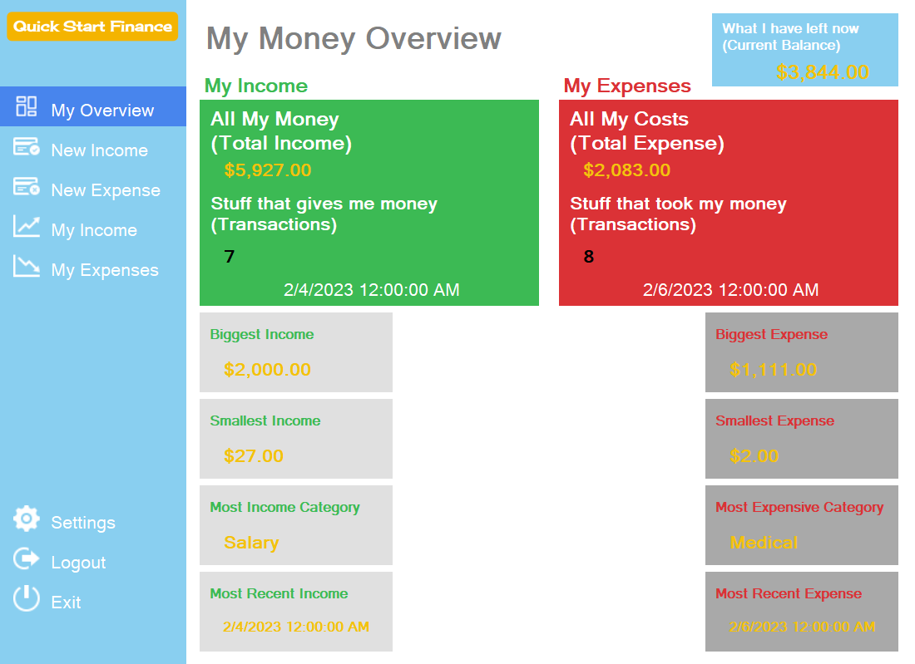
Quick Start Finance
Desktop Application Iteration

Slide 5
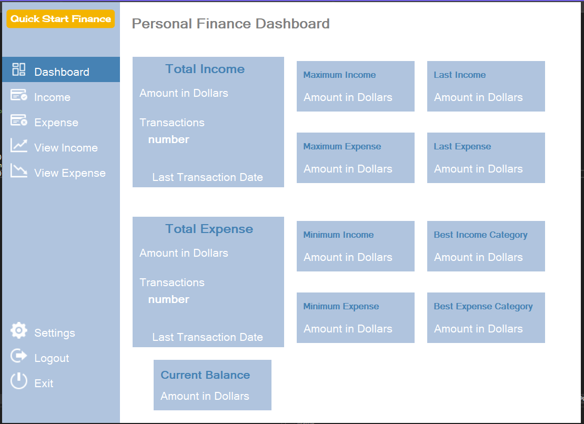
Project UI Evolution
First Winforms Prototype
Quick Start Finance Version 1.0
accounting lingo & plain
more alive & down-to-earth

Slide 6
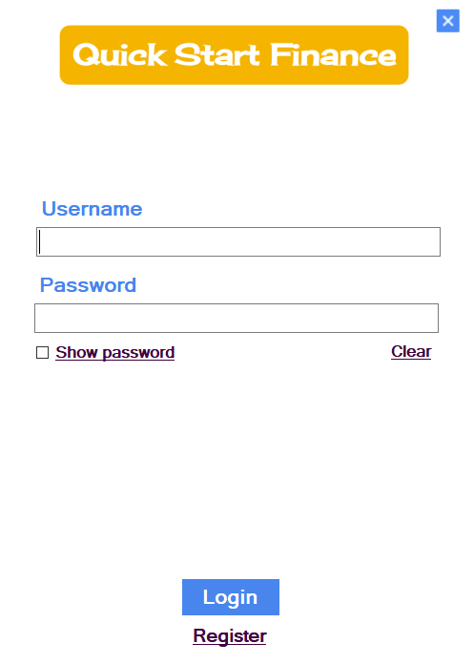
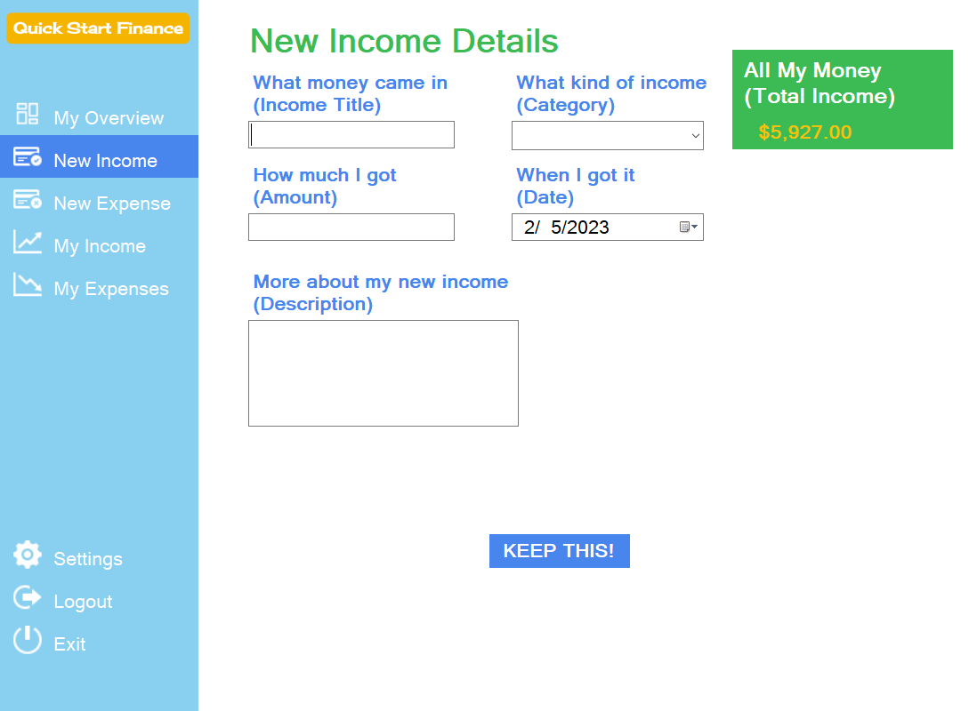
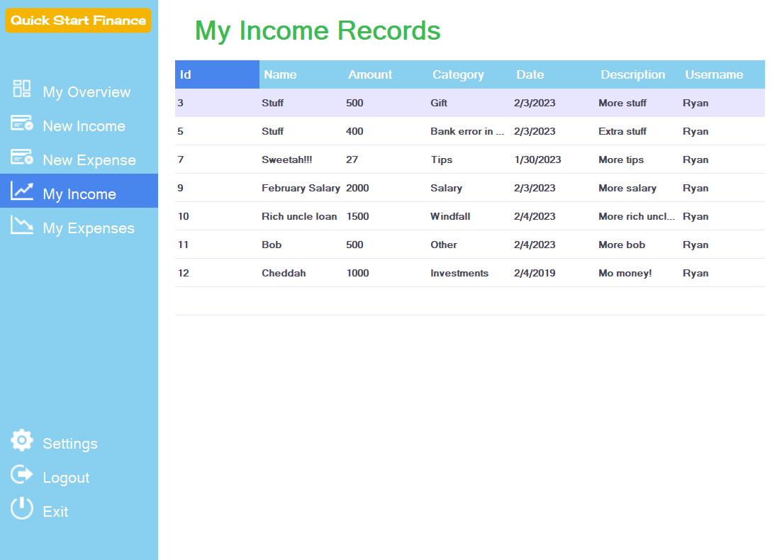
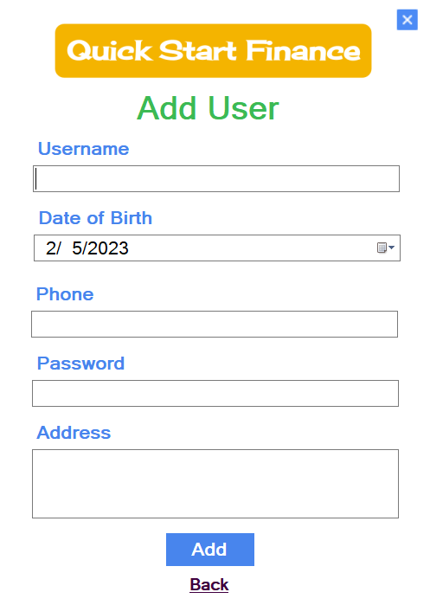
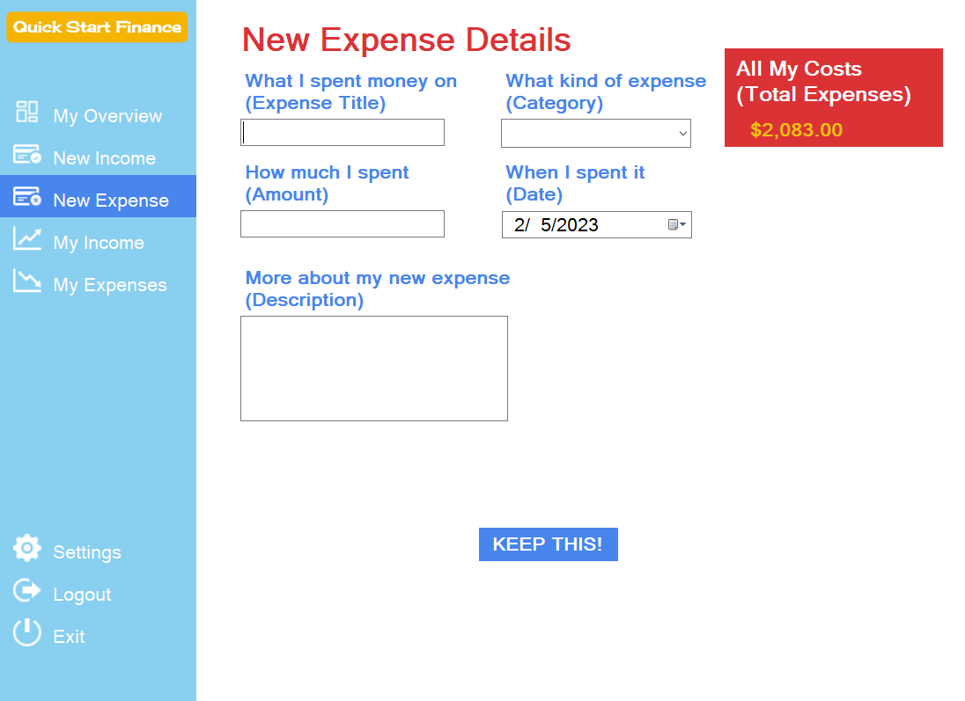
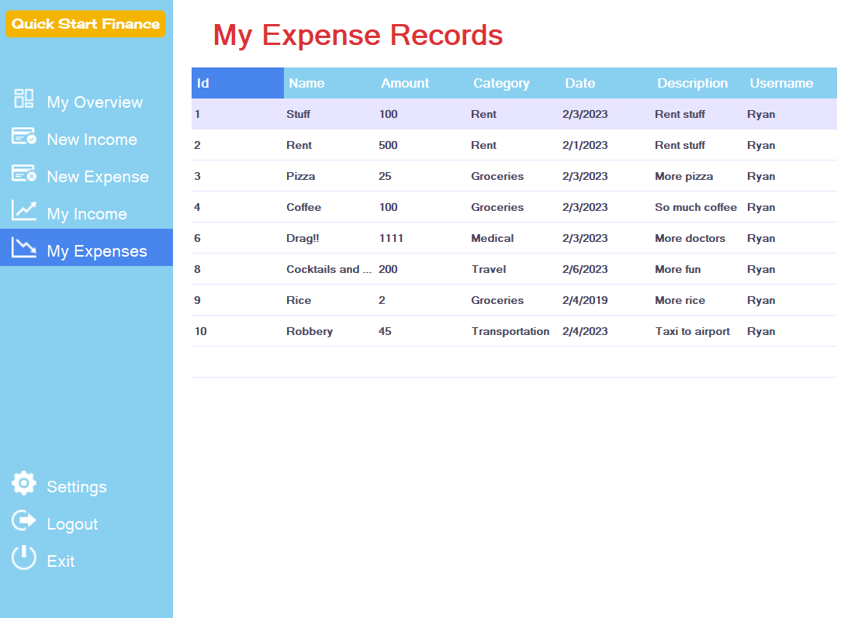
Simple and Easy

Slide 7
How-to Guide
Step 1 – Install and start up
Register
Login
Step 2 - Add new income record
Step 3 - View all income records
Step 4 - Add new expense record
Step 5 - View all expense records
Step 6 - View and understand Dashboard

Slide 8
Limitations
A “Younger” Personal Finance Application
May be of use to older users for the simple transactions mentioned above
Limited application
Not a good fit for someone with complex needs, such as investments, retirement, taxes or mortgages
Not income statements or balance sheets
More mature users may find the interface childish or naïve.
Again, we are specifically targeting the youth.

Slide 9
Resources
Please go to our website for download, tutorials and support documentation:
https://www.ryangineer.com/quickstartfinance

Slide 10
Thanks for your time!
Any questions?

